Slide 1
Collaborative Filtering Algorithm Based
Movie Recommender System
PRESENTED BY
1245994 Chao Cao
1245826 Jiayu Xi
1246260 Ruilei Zhao
1259652 Zilu Huang
Instructor：Houwei Cao

Slide 2
Content
01 Introduction
02 Data
03 Frontend
04 Backend
05 Conclusion
06 References

Slide 3
Part One
Introduction

Slide 4
01
Part One
Introduction
Background
-Design a movie recommender system based on the user's preference.
-Build a community for the user to rate and comment.
-More and more people watch a movie on the couch, and COVID is going strong in some area.

Slide 5
01
Part One
Website show time
1. Register and login
5. Collect movies
2. Information Details
6. Comment
3. Recommendation
(User –based & Item-based)
7. Search
4. User rating
8. Background management

Slide 6
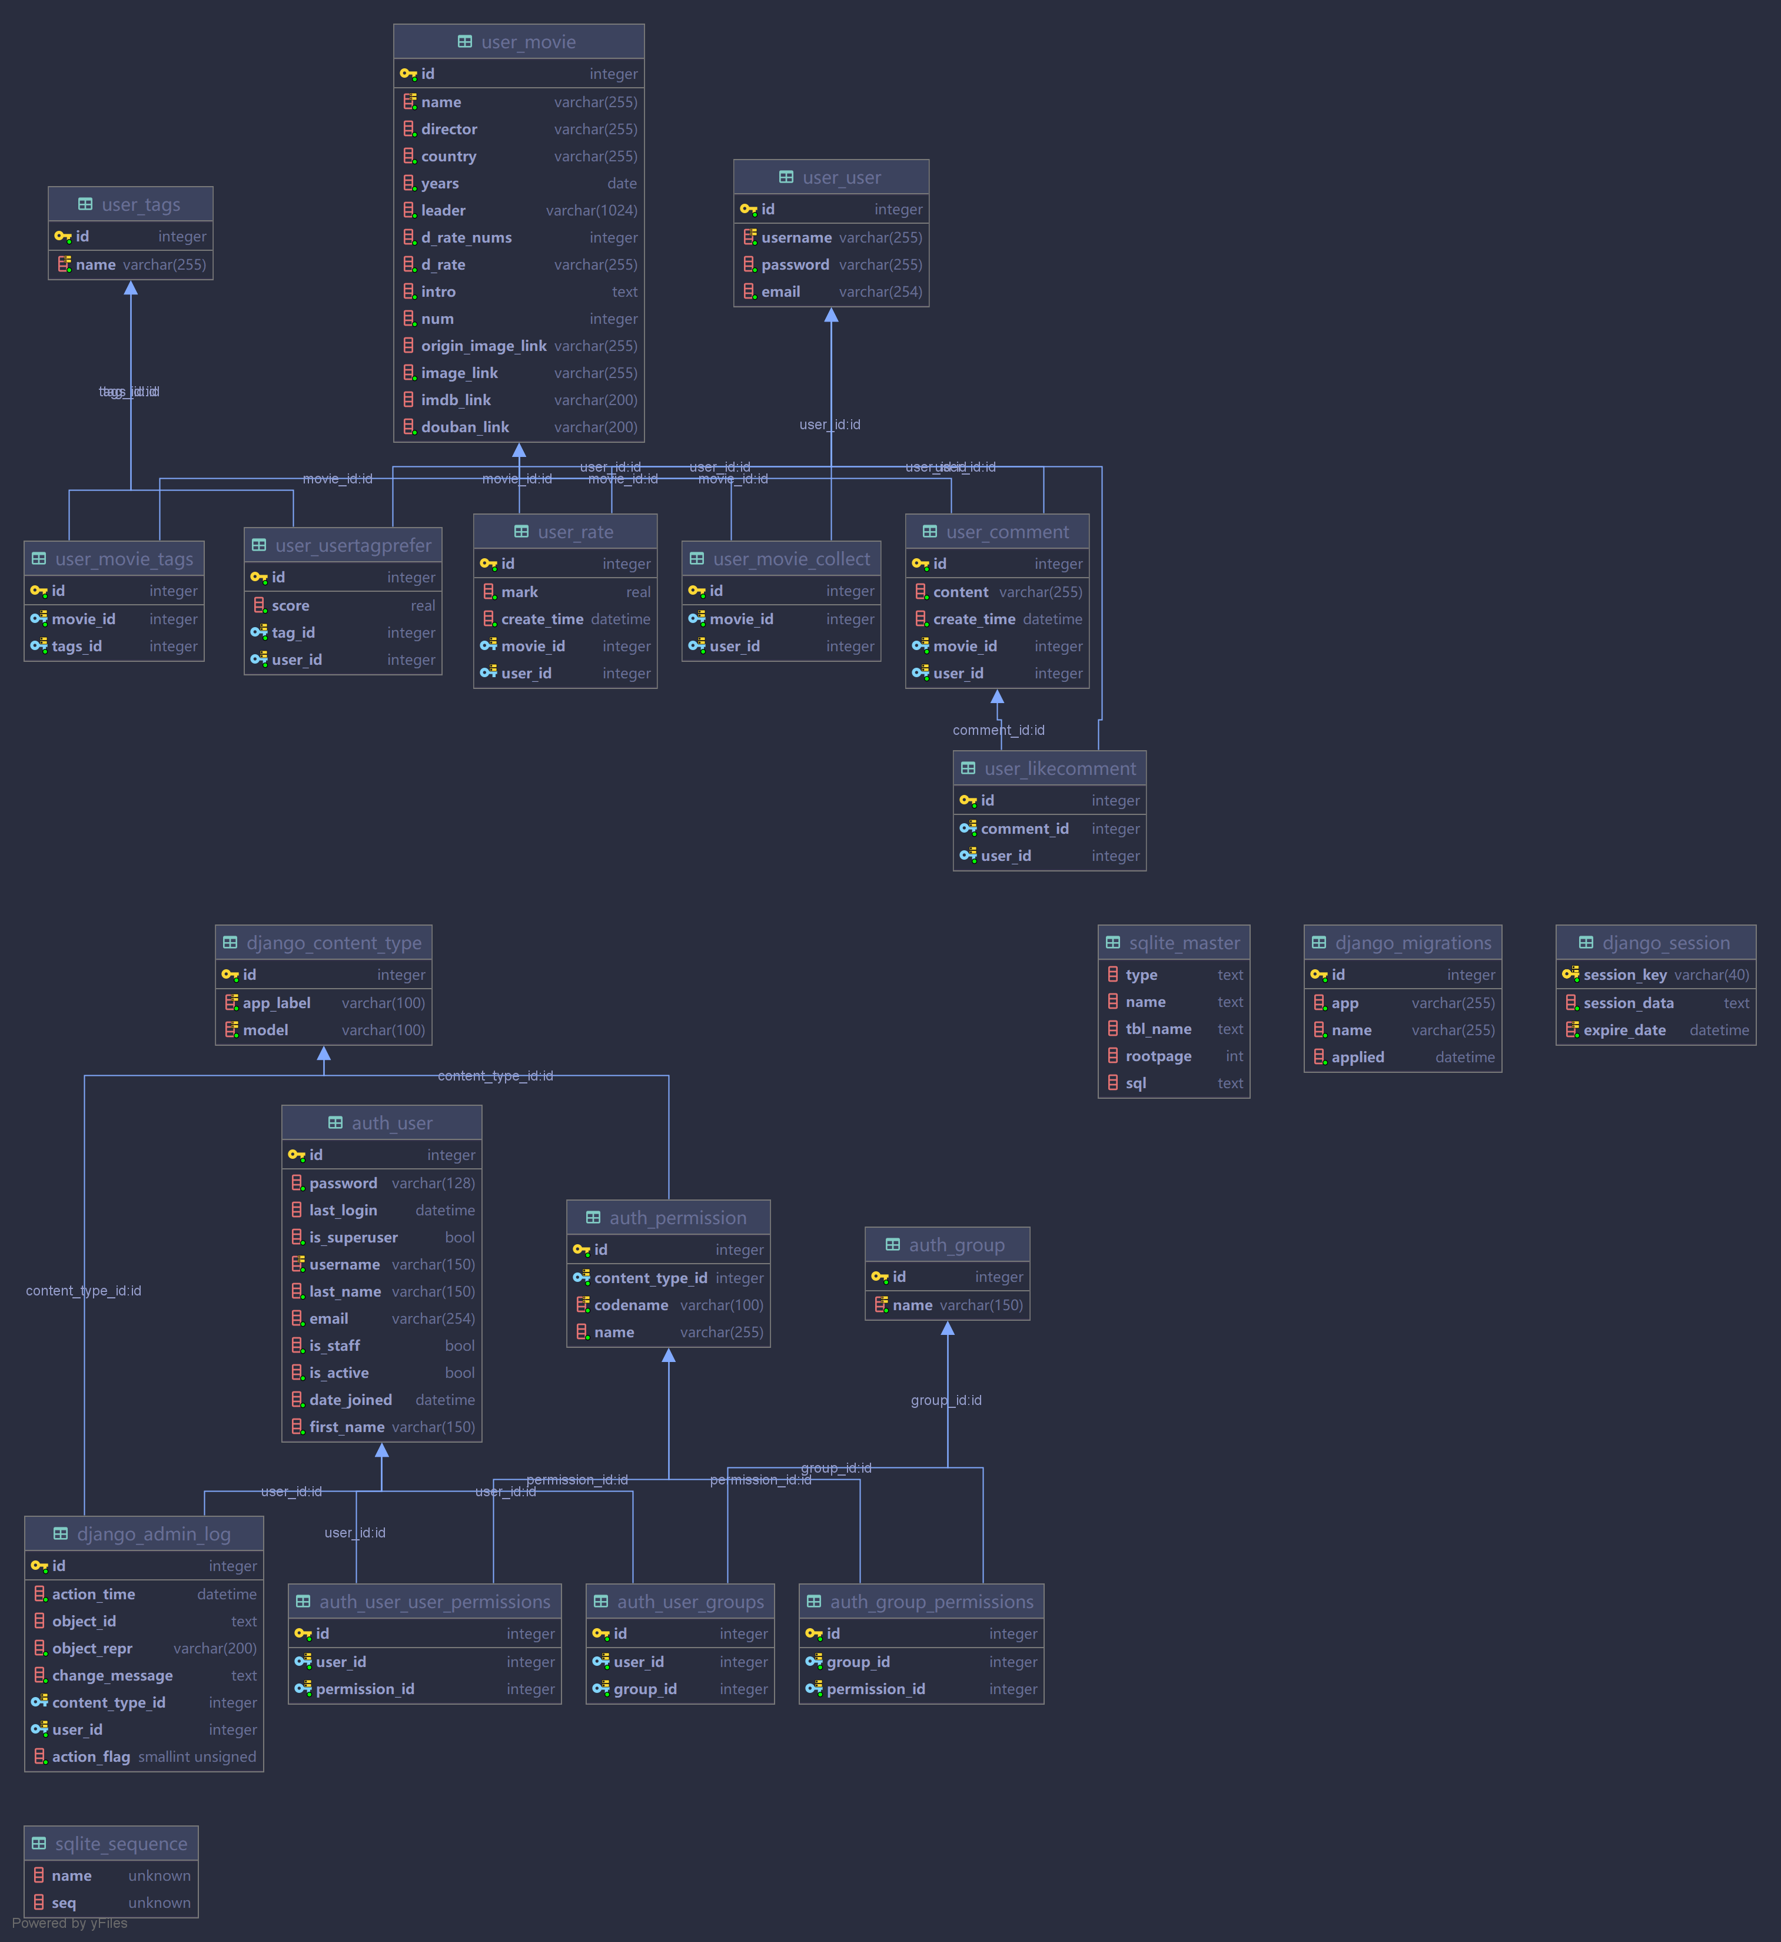
SQLite is written in ANSI-C and provides a simple and easy to use API.
01
Part One
Database Visualization

Slide 7
Part Two
Data

Slide 8
02
Part Two
Data Details
Attributes of movie information
id
title
link
country
years
directors
actors
rating
tags
description
imdb
description
length
Douban Link
Attributes of user reviews information
user id
review time
review content
We crawled data from 38,738 movies
After excluding the blank data, we have 21,673 movies.
Each movie contain 500 reviews
(To facilitate the operation, the project contains 2000 movies)

Slide 9
02
Part Two
Douban Website
Douban Website
(The Shawshank Redemption)
https://movie.douban.com/subject/1292052/

Slide 10

02
Part Two
Crawler
Tool
Bypass a series of complex communication processes
Target
Problem & Result
information of movies reviews of movies
Douban has a limit of 50 pages of reviews
Save them to an Excel file

Slide 12
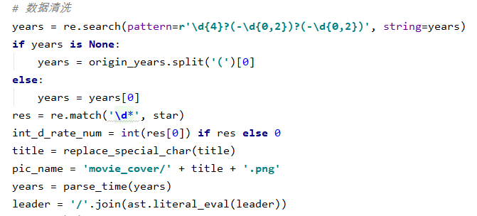
02
Part Two
Data Cleaning
Data Cleaning
Reasons
There is some duplication of data.
Raw data is full of the noisy information .
We need to use a regular expression to extract the Tags and Actors for each movie, we turn the number of comments on Douban from string to int, and name the posters after the movies.

Slide 13
SQLite is written in ANSI-C and provides a simple and easy to use API.
02
Part Two
Sqlite3
SQLite is one of the fastest growing database engines （the SQLite source code is not copyrighted）.
Sqlite3
Advantages：
No need for a separate server process or system for operation (serverless).
No external dependencies are required.
Not require configuration
Written in ANSI-C.
Provides a simple and easy way to use API.
A software library that implements a self-sufficient, serverless, zero-configuration, transactional SQL database engine

Slide 14
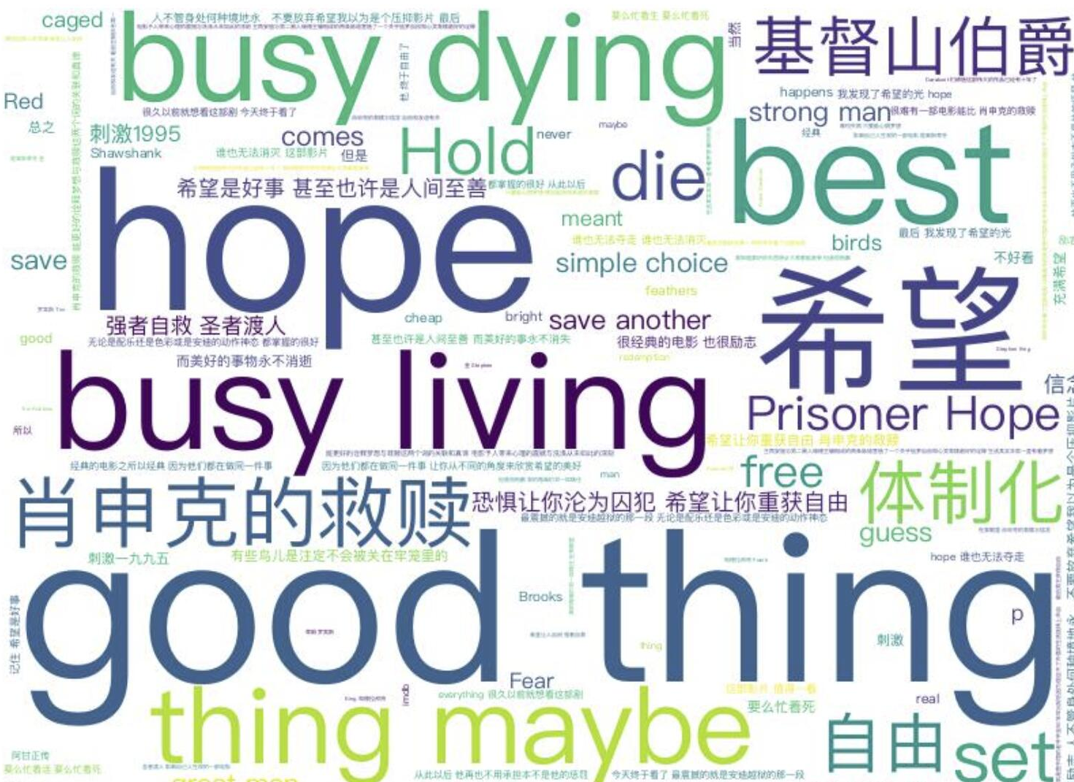
02
Part Two
Word Cloud
We use the Jieba library to segment Chinese words
1
We download stopwordsList to remove the stopwords in the text
2
We use WorldCloud to implement the word cloud function.
3
Key words of movies
——Word Cloud
We take all the reviews of a movie as text, extracts the keywords in these reviews, and then generates an image based on the frequency of the comments.

Slide 15
Part Three
Backend

Slide 16
03
Part Three
Technology
Backend
django
djangorestframework (MVC Framework)
Algorithm
Python
Collaborative filtering recommendation algorithm based on user and Item
Database
Sqlite3

Slide 17
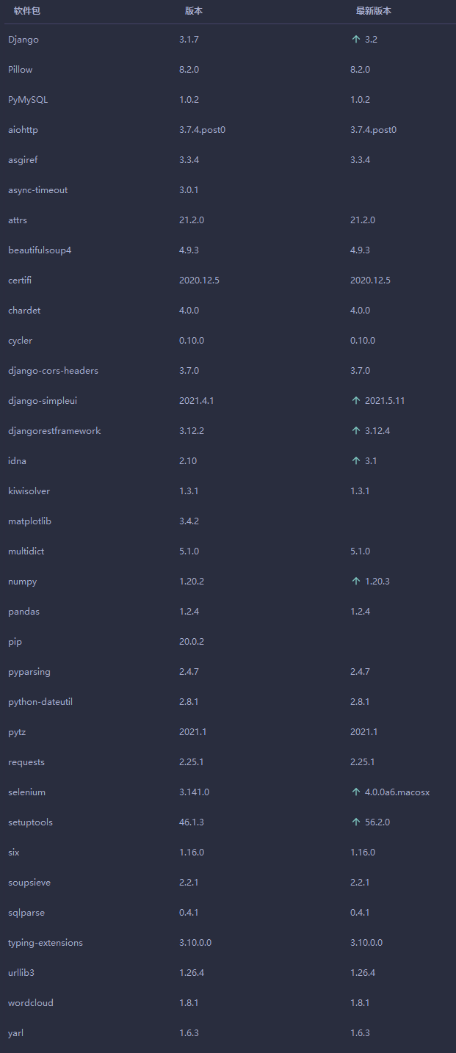
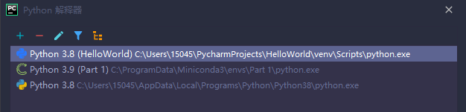
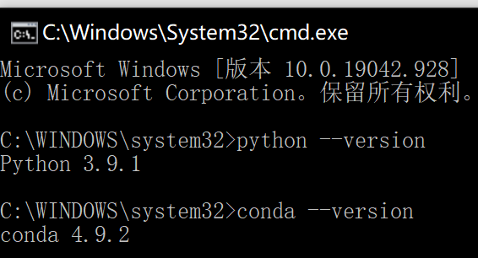
03
Part Three
Python
Software Package
Python 3.8
Interpreter:
Virtualenv
Conda

Slide 18
03
Part Three
Django
Python + Django = the best combination for rapidly developing, designing, and deploying websites.
Django
Advantages：
Powerful database features
Comes with powerful back office functions
Elegant URLs
an open source web application framework written in Python.

Slide 19
03
Part Three
Algorithm
Collaborative filtering recommendation algorithm based on user and Item
Three categories of recommendation engines
Demographic-based Recommendation
Content-based Recommendation
Collaborative Filtering-based Recommendation:
User-based Collaborative Filtering Recommendation
Item-based Collaborative Filtering Recommendation
Model-based Collaborative Filtering Recommendation

Slide 20
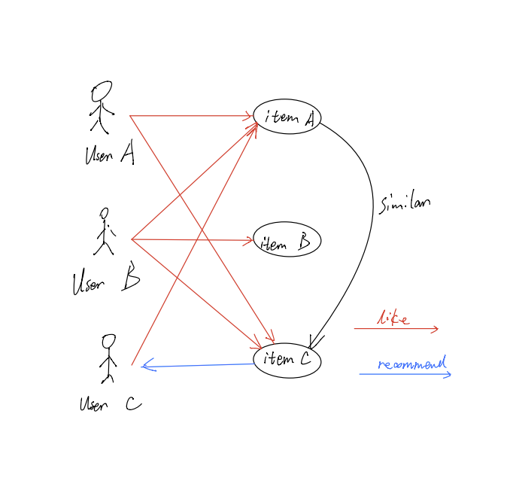
03
Part Three
Algorithm
Item-based Collaborative Filtering Recommendation
Based on all users' ratings of items or information, the similarity between items and items is found, and then similar items are recommended to that user based on the user's historical preference information.
Calculate the item similarity matrix.
Iterate through the items scored by the current user and calculate the similarity distance with the unscored items.
Sort the similarity distance Return

Slide 21
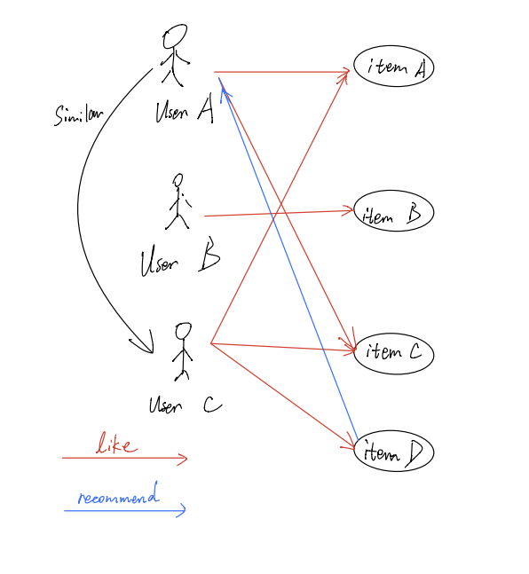
03
Part Three
Algorithm
User-based Collaborative Filtering Recommendation
Use similarities in user access behavior to recommend resources to each other that may be of interest to users
Users need to rate the movie. If the user has not scored the movie, or if there is no other user, the movie will be returned in descending order of the number of views.
calculate the distance between users by pearson algorithm, and find the nearest N users. Return the movies that have been scored by these users (and the part that has not been seen by the user to be recommended).

Slide 22
Part Four
Frontend

Slide 23
04
Part Four
Technology
Bootstrap 3
Vue 2
Frontend
JQuery

Slide 24
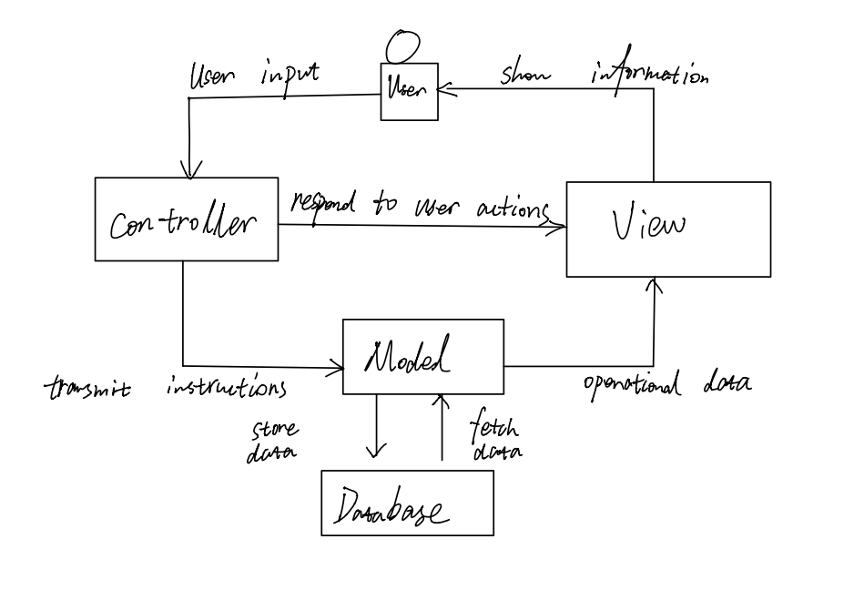
04
Part Four
MVC
Python + Django = the best combination for rapidly developing, designing, and deploying websites.
MVC framework
Django is based on MVC model
Model (M) - Writing the functions that the program should have, responsible for mapping business objects to the database (ORM).Comes with powerful back office functions
View (V) - graphical interface, responsible for interaction with the user (page).
Controller (C) - Responsible for forwarding requests and processing them.

Slide 25
04
Part Four
MVC
Low coupling
High reusability and applicability
Lower life cycle cost
Rapid deployment
MVC framework
Django is based on MVC model

Slide 26
Part Five
Conclusion

Slide 27
05
Part Five
Conclusion
populate_user_data.py
Randomly generate 200 user and user ratings
Crawler
Setting reasonable time intervals
Using multiple computers
Problems & Solutions
Data Collection
Cold Start
Douban has an anti-crawl mechanism
First time user data is missing, normal recommendation function can't work

Slide 28
05
Part Five
Future Work
1
2
3
Affiliate with more movie sites
Time Trend Graph
Dynamic changes
Rotten Tomatoes
IMDB
Movielens
mtime
Short-term popular reviews
Changes in scores in the short term
Real-time movie updates
Automatic removal of invalid information

Slide 29
05
Part Five
Contribution
Chao Cao | Data collection | Backend Construction Database Management
Jiayu Xi | Coding crawlers Data collection |  | Data Cleaning Statics Analysis
Zilu Huang | Data collection |  |  | Debug General Organization
Ruilei Zhao | Data collection |  |  |  | Frontend Web Design
Learning& Sharing

Slide 30
Part Six
Reference

Slide 31
06
Part Six
Reference
https://www.zhihu.com/question/19971859
https://www.jianshu.com/p/5463ab162a58
GlobalWebIndex. "Increased Time Spent on Media Consumption Due to The Coronavirus Outbreak among Internet Users Worldwide as of March 2020, by Country." Statista, Statista Inc., 23 Mar 2020, https://www-statista-com.arktos.nyit.edu/statistics/1106766/media-consumption-growth-coronavirus-worldwide-by-country/
Bloomberg. (March 18, 2020). Coronavirus impact: growth in time spent streaming TV and video worldwide in the weekend of March 13 to 14, 2020 [Graph]. In Statista. Retrieved May 15, 2021, from https://www-statista-com.arktos.nyit.edu/statistics/1107559/video-streaming-consumption-growth-worldwide-coronavirus/
YUAN Quan, CHENG Zhen-hua, & JIANG Yang. (2020). A movie recommendation algorithm based on knowledge graph and collaborative filtering. Computer Engineering & Science / Jisuanji Gongcheng Yu Kexue, 42(4), 714–721. https://doi-org.arktos.nyit.edu/10.3969/j.issn.1007-130X.2020.04.019
https://www.sciencedirect.com/science/article/pii/S1045926X14000901

Slide 32
THANK YOU
FOR WATCHING
PRESENTED BY
1245994 Chao Cao
1245826 Jiayu Xi
1246260 Ruilei Zhao
1259652 Zilu Huang
Instructor：Houwei Cao

